Slide 1


Computer Architecture Experiment
lab7
College of Computer Science & Engineering
Zhejiang University

Slide 2
Topics
0、Basic knowledge
1、Function Units design
2、Single-cycle CPU design
3、Multiple-cycle CPU design
4、5-stage of pipelined CPU design
5、Pipelined CPU with stall
6、Pipelined CPU with forwarding
7、Pipelined CPU resolving control hazards
8、Pipelined CPU support execution 16 MIPS Instructions
9、Review

Slide 3
Outline
Experiment Purpose
Experiment Task
Basic Principle
Operating Procedures
Precaution

Slide 4
Experiment Purpose
Understand why and when Control Hazards arise
Master the methods of resolving Control Hazards
Freeze or flush
Predict-not-taken
Predict-taken
Delayed-branch
Master the methods of 1-cycle stall of Predict-not-taken and Predict-taken branch.
master methods of program verification of Pipelined CPU resolving control hazards

Slide 5
Experiment Task
Improve the design of Datapath of 5-stages Pipelined CPU via reducing 3 control stall to 1 stall when using flush
Bring forward calculation of condition & branch address
Bring forward bypass unit
Verify the Pipeline CPU with program and observe the execution of program

Slide 6
Control Hazard Definition
Control Hazards arise from the pipelining of branches and other instructions that change the PC.
Control hazards can cause a greater performance loss for our MIPS pipeline compared with data hazards.
Reducing Pipeline Branch Penalties.

Slide 7
Instruction Demo

Slide 8
Execution result

Slide 9
Methods of resolving Control hazards
Freeze or flush the pipeline
Predict-not-taken
Predict-taken
Delayed branch

Slide 10
Freeze method

Slide 11
Predict-not-taken( not in lab)
How to implement it ?
Normally: pc←pc+4, no stall whenever ((exop or memop )== branch)
If mem_op=branch and condition_code==1, then Kill the following 3 instructions flying in pipeline.

Slide 12
Predict taken only when branch target can be got earlier that condition code
However there’s no advantage for MIPS pipeline, but if the datapath can be changed as following.
NOT in Lab too.

Slide 13
Reduce the control stall by calculate target and cc asap.
Bring forward calculation of branch condition from MEM Stage to EX Stage, stall reduce from 3-cycle to 2-cycle.

Slide 14
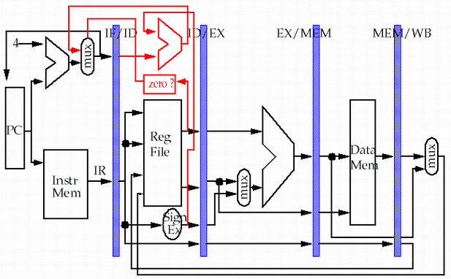
Reduce the control stall by calculate target and cc asap.
Then bring forward from EX to ID, stall reduce from 2-cycle to 1-cycle.
store
load

Slide 15
What we have done by far

Slide 16
The control logic
Stall
Control stall: ex_op / mem_op is branch or jmp. (Flush)
Load stall: (ex_op=lw) & ((ex_rd=id_rs) & exist_id_rs)
or ((ex_rd= id_rt) & exist_id_rt )
FWA:
1: (ex_op=ALUop) && ((ex_rd=id_rs) & exist_id_rs)
2: (mem_op=ALUop/LWop) && ((mem_rd=id_rs) & exist_id_rs)
0:
FWB:
1: (ex_op=ALUop) && ((ex_rd=id_rt) & exist_id_rt)
2: (mem_op=ALUop/LWop) && ((mem_rd=id_rt) & exist_id_rt)
0:

Slide 17
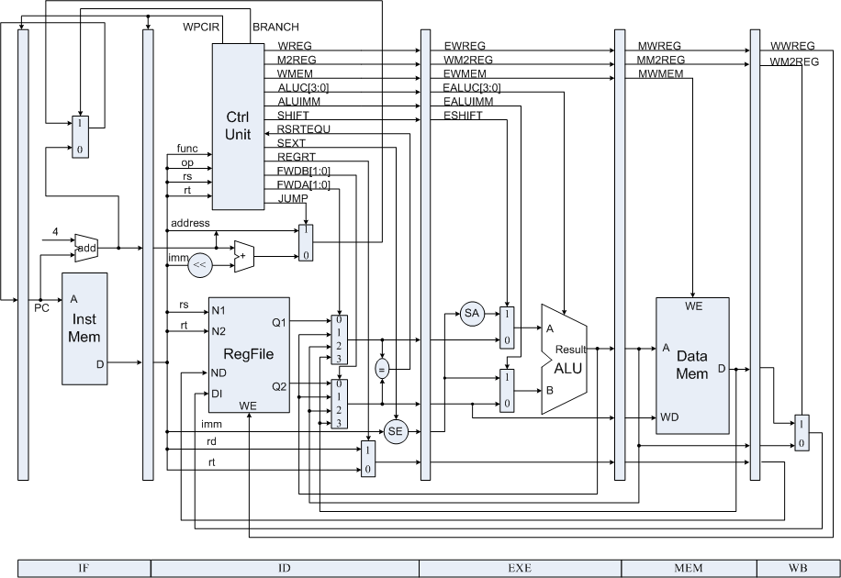
Datapath resolving Control Hazards

Slide 18
Why Move the forwarding control logic to ID stage ?
Before improvement
alu r1, r2, R3
Ifetch
Reg
ALU
DMem
Reg
CC &
Target is OK
BNE r4,r1,L1
Ifetch
Reg
ALU
DMem
Reg
What if CC and target is calculated in ID stage ?
alu r1, r2, R3
Ifetch
Reg
ALU
DMem
Reg
Bubble
BNE r4,r1,L1
Ifetch
Reg
ALU
DMem
Reg

Slide 19
Why Move the forwarding control logic to ID stage ?
alu r1, r2, R3
Ifetch
Reg
ALU
DMem
Reg
BNE r4,r1,L1
Bubble
Ifetch
Reg
ALU
DMem
Reg
Move the forwarding control logic into ID stage,
and Also, send out ALUoutput and LWDR earlier before the latch.
alu r1, r2, R3
Ifetch
Reg
ALU
DMem
Reg
CC &
Target is OK
BNE r4,r1,L1
Reg
ALU
Ifetch
DMem
Reg

Slide 20
Move forward the forwarding control logic & send out ALUoutput/LWDR before the latch.

Slide 21
But new stall still arise
LW r1, 8(r2)
Ifetch
Reg
ALU
DMem
Reg
Bubble
BNE r4,r1,L1
Ifetch
Reg
ALU
DMem
Reg
So what about your stall logic and forwarding control logic ?

Slide 22
Precautions
1、According to datapath to modify the modules of top module, then modify the definitions of the modules.
2、The signals which transfer from former stage to later stage should be stored to stage registers temporally.
3、Bring forward Bypass Unit to ID Stage (3 selection sources: EXE.ALU, MEM.ALU, MEM.LW)
4、Bring forward Calculations of Condition and Branch Address to ID Stage.
5、JUMP Instruction. (After JUMP is A Stall)

Slide 23
Observation Info
Input
West Button: Step execute
South Button: Reset
4 Slide Button: Register Index
Output
0-7 Character of First line: Instruction Code
8 of First line : Space
9-10 of First line : Clock Count
11 of First line : Space
12-15 of First line : Register Content
Second line : “stage name”/number/type
stage name: 1-”f”, 2-”d”, 3-”e”, 4-”m”, 5-”w”

Slide 24
Program for verification
 | Instruction | Bin Code | Address | Inst. Type
 | lw r1, $20(r0) | 0x8c01_0014 | 0 | 6
 | lw r2, $21(r0) | 0x8c02_0015 | 1 | 6
 | add r3, r1, r2 | 0x0022_1820 | 2 | 1
 | add r2,r0,r0 | 0x0000_1020 | 3 | 1
 | sub r4, r1, r3 | 0x0023_2022 | 4 | 2
 | and r5, r3, r4 | 0x0064_2824 | 5 | 3
 | or r7, r5, r7 | 0x00a7_3825 | 6 | 4
 | beq r5,r7,-6 | 0x10a7_fffa | 7 | 8
 | add r7,r0,r1 | 0x0001_3820 | 8 | 1
 | jmp 0 | 0x0800_0000 | 9 | 9
 | Add r7, r0, r0 | 自己编码 | A | 1

Slide 25
Thanks!

